Slide 1

Welcome

Slide 2
Presentation on “ Video games & exploration of different categories ”

Slide 3
Group name : CYBORG
Group members :
1. Name : SAYED ATIK JAWAD ID : 2015100000044 2. Name : SHAPON KUMAR ROY ID : 2016000000166 3. Name : REFAT REHMAN ID : 2016000000165 4. Name : KHALID HOSSAIN ID : 2016000000191

Slide 4
Overview of today’s presentation
Survey
Limitations
Suggestions
Conclusion
References
Q&A Session
Abstract
Introduction
Body of the Research paper
Action
Action-Adventure
Adventure
Shooter
Role Playing Game (RPG)
Sports
Strategy
Life Simulation
Construction & Management Simulation
Idle Gaming
Other notable games

Slide 5
Abstract :
Video games category is used to category video games on their game play interaction rather than visual or narrative differences. A video game genre is defined by a set of game play challenges. They are classified independent of their getting or game – world content, unlike other works of fiction such as films or books. For example an action game is still an action game, regard – less of whether it takes place in a fantasy world or outer space. Within game studies there is a look of consensus in reaching accepted formal definition for game categories, some being more observed than others. Like any taxonomy, a video game genre requires certain constants. Most video games feature obstacles to overcome, so video games category can be defined where obstacles are completed in substantially similar ways. This research consists a listing of commonly used video games genre with brief description and examples of each. This list is by no means complete or comprehensive. Chris Crawford notes that the state of computer game design is changing quickly. We would therefore except the taxonomy presented here to genre classification, the matter of any individual video game’s specific category is open to personal interpretation. Moreover, it is important to be able to “think of each individual game as belonging to several categories at once”.

Slide 6
Introduction :
We 4 group mates have prepared a research on the different types of games on several categories. Some can be played on console, some can be played on P.C. Some can be played in mobile phones too. But as the biggest collection of games had been referencing from the very fast of the invention of computer.
In our research we tried to elaborate the genres of these games in detail. The reader must have to found to ultimate glance of different types of games in a complete package often reading our paper.

Slide 7
Body action :
Action game requires players to use quick reflexes, accuracy , and timing to overcome obstacles.
It is perhaps the most basic of gaming genres, and certainly one of the broadest.
Action games tend to have game play with emphasis on combat.
There are many subgenres of action games, such as fighting games and first-person shooters.
ACTION-ADVENTURE :
Action -adventure games combine elements of their two component genres, typically featuring long-term obstacles that must overcome using a tool or item as leverage(which is collected earlier),as well as many smaller obstacles almost constantly in the way, that require elements of action games to overcome.
Action adventure games tend to focus on exploration and usually involve item gathering, simple puzzle solving and combat.

Slide 8
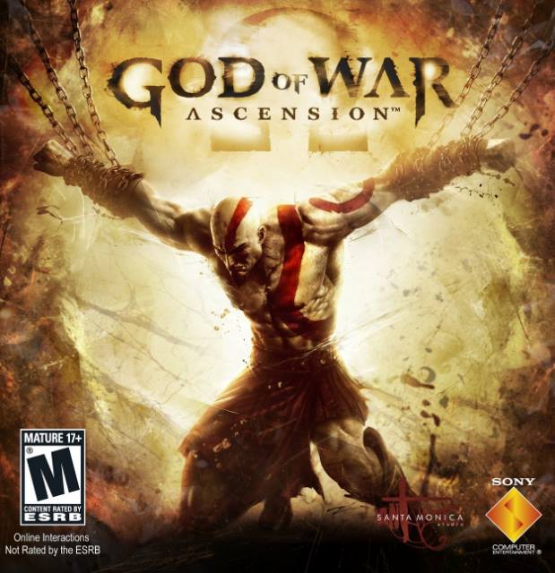




Slide 9
Adventure
Adventure games were some of earliest games created; Beginning with the text adventure Colossal Cave Adventure in the1970s, that game was originally titled simply “Adventure,” and is the namesake of the genre.
Over time, graphics have been introduced to the genre and interface has evolved.
Shooter
A shooter game focuses primarily on combat involving projectile weapons, such as guns and missiles.
They can be divided into first-person shooters use light gun technology.
First-person shooter video games, commonly known as FPs, emphasize shooting and combat from the perspective of the character controlled by the player.
Tactical shooters are variations on the first-and third-person shooter genre, which focus on realism and emphasize tactical play such as planning and teamwork.
Third-person shooter video games, known as TPSs, emphasize shooting and combat from a camera perspective in which the player character is seen at a distance.

Slide 10






Slide 11
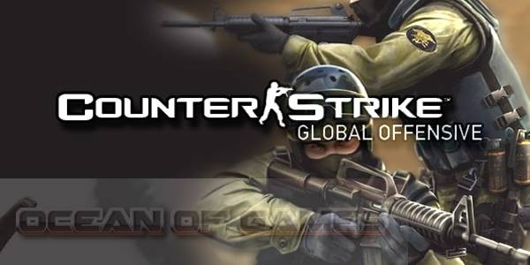






Slide 12
Role playing
Role playing video games draw their game play from traditional role playing games like dungeons & dragons.
Most cast the player in the roll of one or more “adventurers “ who specialize in specific skill sets ( such as combat or costing magic spells ) while progressing through a predetermined storyline .
Sports
Sports are video games that simulate sports.
This opposing team(s) can be controlled by other life people or artificial intelligence.
Some types of sports games are
Racing
Sports game
Competitive
Sports-based fighting

Slide 13





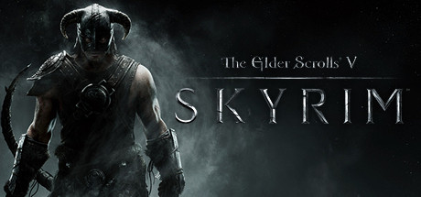

Slide 14






Slide 15
Strategy
Strategy video games focus on game play requiring careful and skillful thinking and planning in order to achieve victory and the action scales from world domination to squad-based tactics.
Some strategic types games are :
4x games
Artillery game
Real-time strategy (RTS)
Real-time tactics (RTT)
Programming game
Logic game
Trivia game
Board game/ Card games.
Life simulation
Life simulation games (or Artificial Life Games) involve living or controlling one or more artificial lives.
A life simulation game can revolve around individual and relationships, or it could be simulation of an ecosystem.
Biological simulation, Pet raising simulation, Social simulation are some of this type of games.

Slide 16


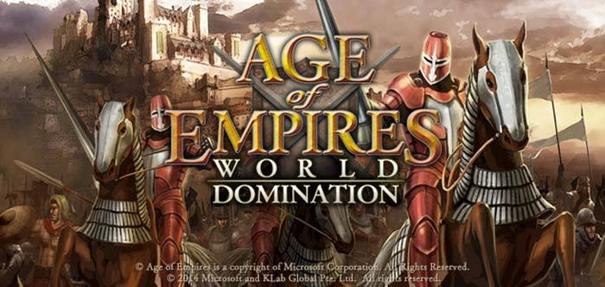
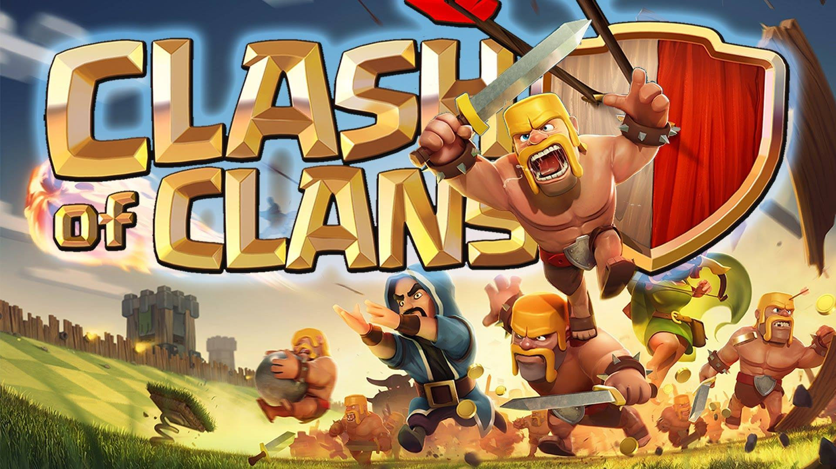

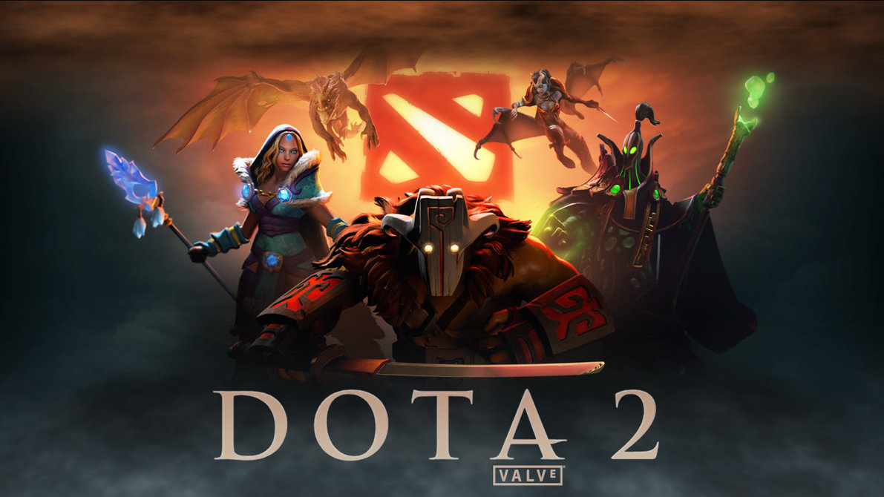


Slide 17
Construction and management simulation
Construction and management simulation games or (CMSs) are a type of simulation game which task players to build, expand or manage fictional communities or projects with limited resources.
Perhaps the most known game of this type is SimCity, which is still popular and has had great influence on later city-building games.
Business simulation games generally attempt to simulate an economy or business, with the player controlling the economy of the game.
A government simulation game or “political game”) involves the simulation of the policies, government or politics of a country, but typically excludes warfare.
Idle Gaming
This genre involves games that orient the player with a trivial task, such as clicking a cookie ; and as the game progress, the player is gradually rewarded certain upgrades for completing said task.
In all, these games require very little involvement from the player, and in most cases they play themselves; hence the use of the word “idle”.

Slide 18





Other notable genres
MMO
Casual game
Music game
Party game
Programmer game
Turn-based tactics (TBT)
War-game
Grand strategy war-games.

Slide 19
Survey
When working on our research paper, we asked many young aged students & gamers for the interest of their games. We surveyed over 80 people about different genres of games. 19 out of 80 said they love to play action packed games so much. We asked some of our Southeast University students too for our survey. They were such friendly to help us with our research. Different people have different opinion about their choices and passion about gaming. So here is a chart showing the statistics of people who plays different types of games and love to play them a lot .

Slide 20
Limitations
There were problems we faced to do the research when we were asking several gamers about their opinion.
But we tried our best to do a better research on the various genres of Video games.
Suggestion
In our research, we have seen many types of comments and ideas from the random people. Some suggested that the developers can make mixed type of genre in one focused genre game.
We think the developers like Ubisoft, Unrea Engine, Namco, EA, Ghost-games, Criterion games,4k games and such like game developer company showed feed the through of today’s gamers and make their upcoming games more enjoyable and eye-catching to their clients.

Slide 21
Conclusion
Video games are known to be a time vanishing product from the view of most of the aged persons. But the view has changed now. This different genres games are comparatively and working created a huge work place as game developers. People can store their ideas in these media and can improve their potential in various types of technological knowledge. Moreover, many games have better storylines, plots on several historical places , fights, crimes, several historical places, fights, crimes, several historical characters and soon. Games can know about these epic stories and besides can find the educative part too. However, this research can be a helpful paper for every games in all over the world find more advanced and artificial intelligence enabled category based game and why not? Much or one of it !

Slide 22
References
Aitchison, J. GilAarseth, E., Sedated, S. M., &Sunnanå, L. (2003).A multi-dimensional typology of games. In LevelUp. Presented at the Digital Games Research Association (DiGRA), DiGRA and Utrecht University,Utrecht.
christ, A., &Bawden, D. (1997). Thesaurus construction and use:A practical manual. Aslib, London.
Apperley, T. H. (2006). Genre and game studies: Toward a critical approach to video game genres. Simulation & Gaming, 37(1), 6-23.
Broughton, V. (2008). A faceted classification as the basis of a faceted terminology. Axiomathes, 18(2), 193-210.
Broughton, V., & Slavic, A. (2007). Building a faceted classification for the humanities: principles and procedures. Journal of Documentation, 63(5), 727-754.
Clearwater, D. A. (2011). What defines video game genre? Thinking about genre study after the great divide. Loading…The Journal of the Canadian Game Studies Association, 5(8), 29-49.
Djaouti, D., Alvarez, J., Jessel, J-P., &Methel, G. (2007). Towards a classification of videogames. In Proceedings of the AISB’07 Conference (Scotland, UK).
Djaouti, D., Alvarez, J., Jessel, J-P., &Methel, G. (2008). Play, game, world: Anatomy of videogames. International Journal of Intelligent Games & Simulation, 5(1), 35-39.
Elverdam, C., &Aarseth, E. (2007). Game classification and game design: Construction through critical analysis. Games and Culture, 2(1), 3–22.
Entertainment Software Rating Board. (2010). How much do you know about video games? http://www.esrb.org/about/video-game-industry-statistics.jsp

Slide 23

Question & answer session

Slide 24
Thank you

